Slide 1

Object-Oriented Software Analysis & Design (COMP-3220) Lecture 2 Observer Pattern
School of Computer Science
Faculty of Science
University of Windsor
Dr. Saeed Samet

Slide 2

Big Data Analytics and Database Design
Motivation
We don’t want to miss out when something interesting happens, do we?
We’ve got a pattern that keeps your objects in the know when something they care about happens.
It’s the Observer Pattern
Interesting aspects of Observer
One-to-many relationships
Loose coupling

Slide 3
Big Data Analytics and Database Design
The Weather Monitoring application overview
The system has three components:
The weather station (the physical device that acquires the actual weather data).
The WeatherData object (that tracks the data coming from the Weather Station and updates the displays).
The display that shows users the current weather conditions.

Slide 4
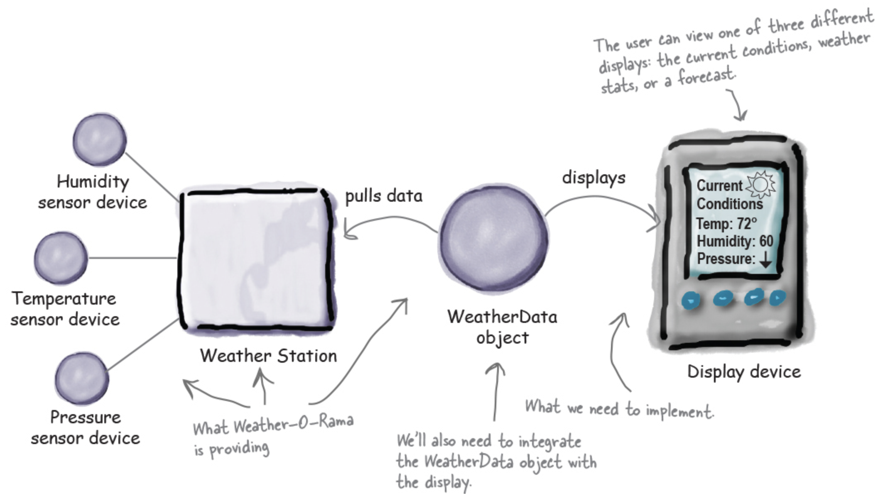
Big Data Analytics and Database Design
The Weather Monitoring application overview
We are responsible for implementing three different display elements:
Current Conditions (shows temperature, humidity, and pressure)
Weather Statistics,
A simple Forecast.

Slide 5
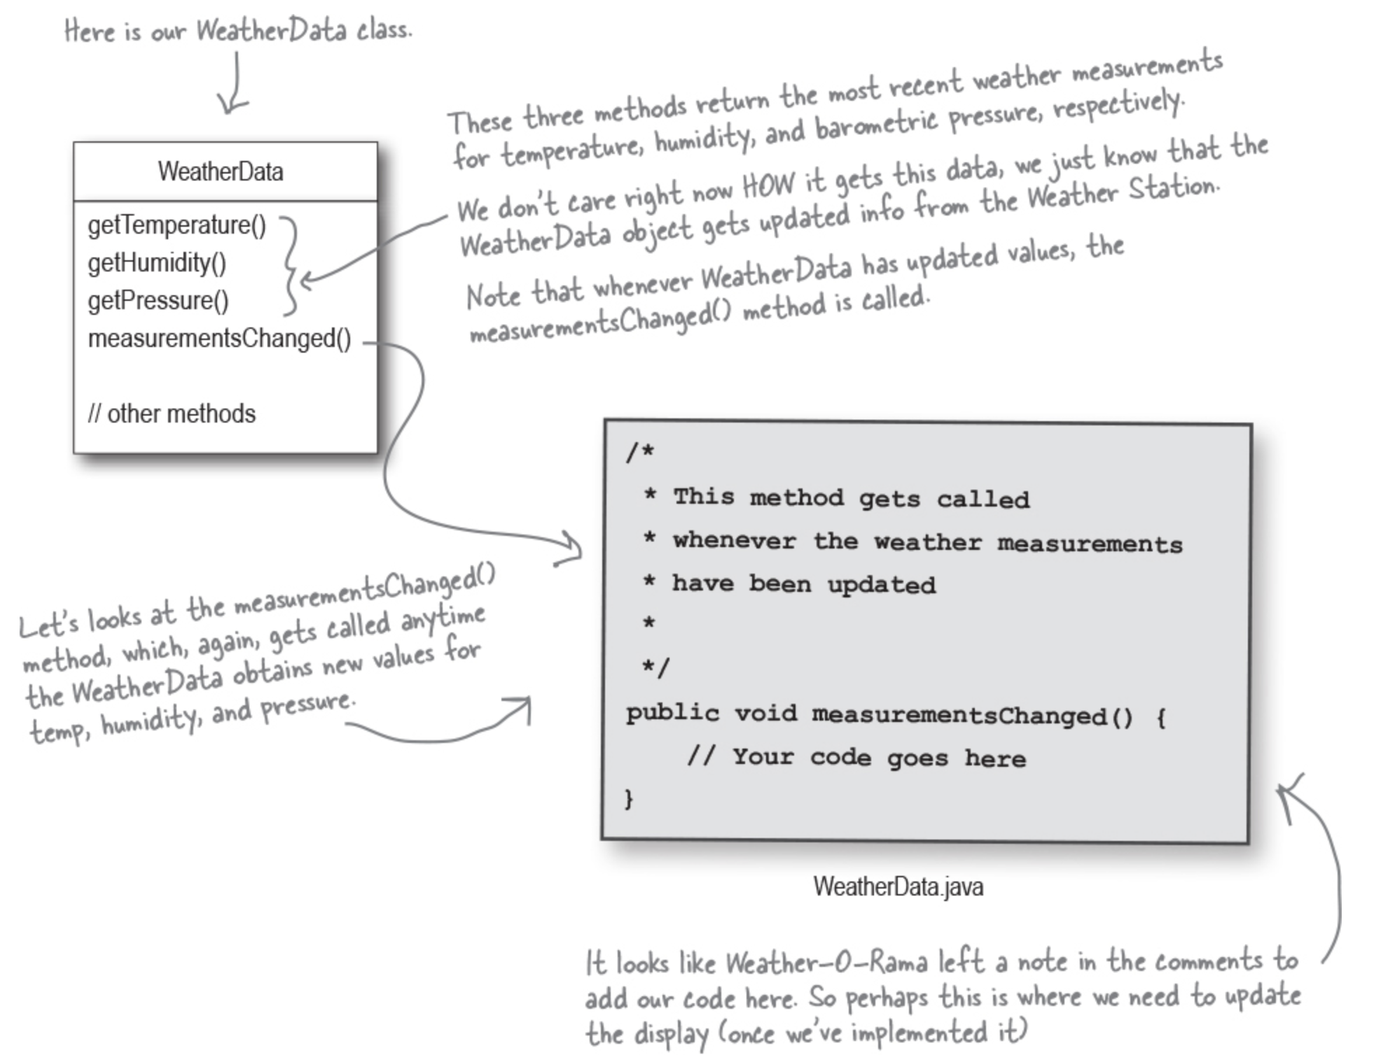
Big Data Analytics and Database Design
Unpacking the WeatherData class

Slide 6
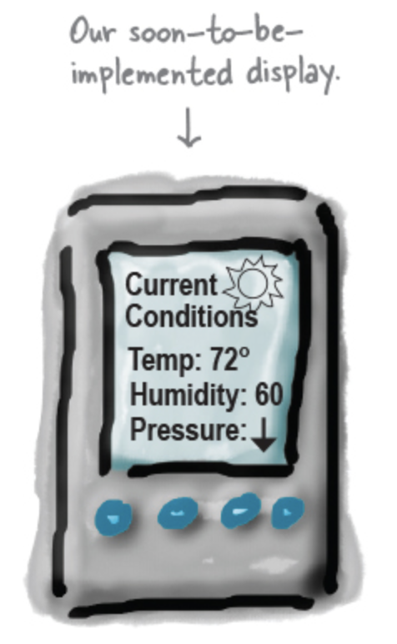
Big Data Analytics and Database Design
The Weather Monitoring application overview
Our job is to alter the measurementsChanged() method so that it updates the three displays for current conditions, weather stats, and forecast.

Slide 7
Big Data Analytics and Database Design
Our Goal
We need to implement a display and then have the WeatherData update that display each time it has new values, or, in other words, each time the measurementsChanged() method is called. But how?
We know the WeatherData class has getter methods for three measurement values: temperature, humidity, and barometric pressure.
We know the measurementsChanged() method is called anytime new weather measurement data is available.
We’ll need to implement three display elements that use the weather data: a current conditions display, a statistics display, and a forecast display. These displays must be updated as often as the WeatherData has new measurements.
To update the displays, we’ll add code to the measurementsChanged() method.

Slide 8
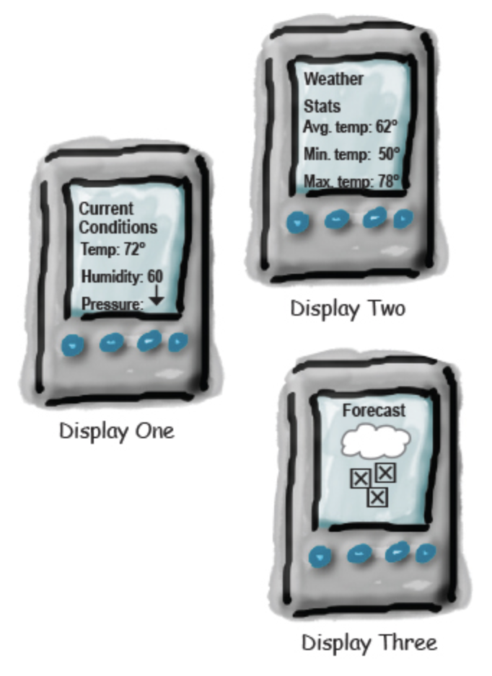
Big Data Analytics and Database Design
Our Goal

Slide 9
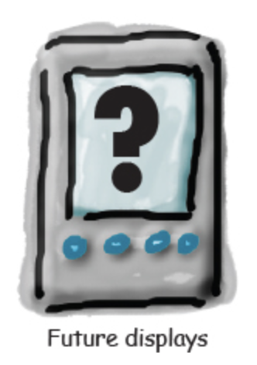
Big Data Analytics and Database Design
Stretch Goal
But let’s also think about the future
We expect, if the Weather Station is successful, there will be more than three displays in the future.
Expandability: Allow users to add (or remove) as many display elements as they want to the application?

Slide 10
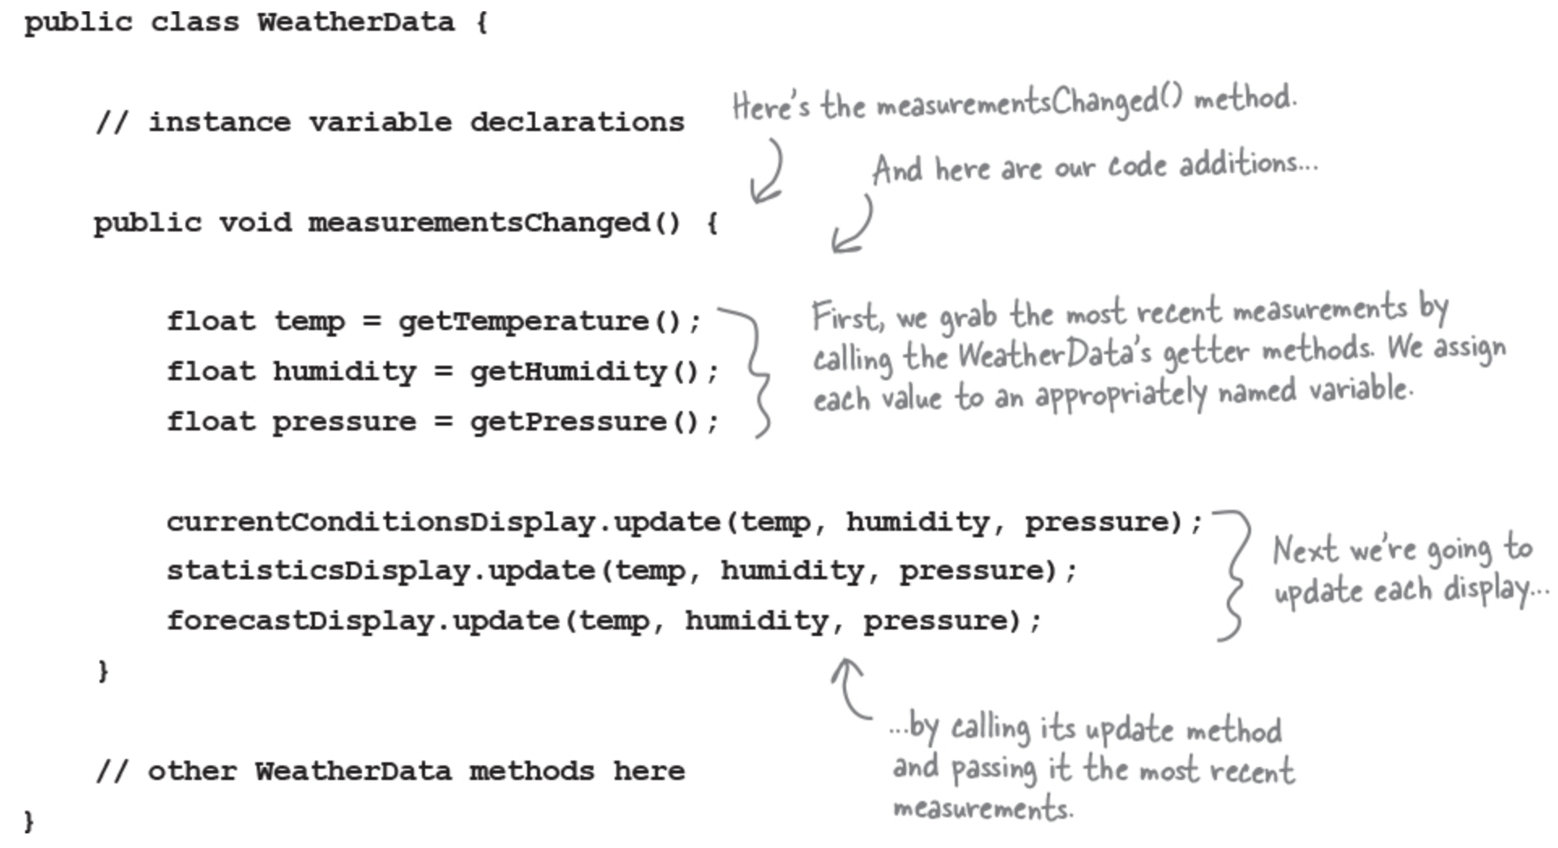
Big Data Analytics and Database Design
Taking a first, misguided implementation of the Weather Station
add our code to the measurementsChanged() method in the WeatherData class:

Slide 11
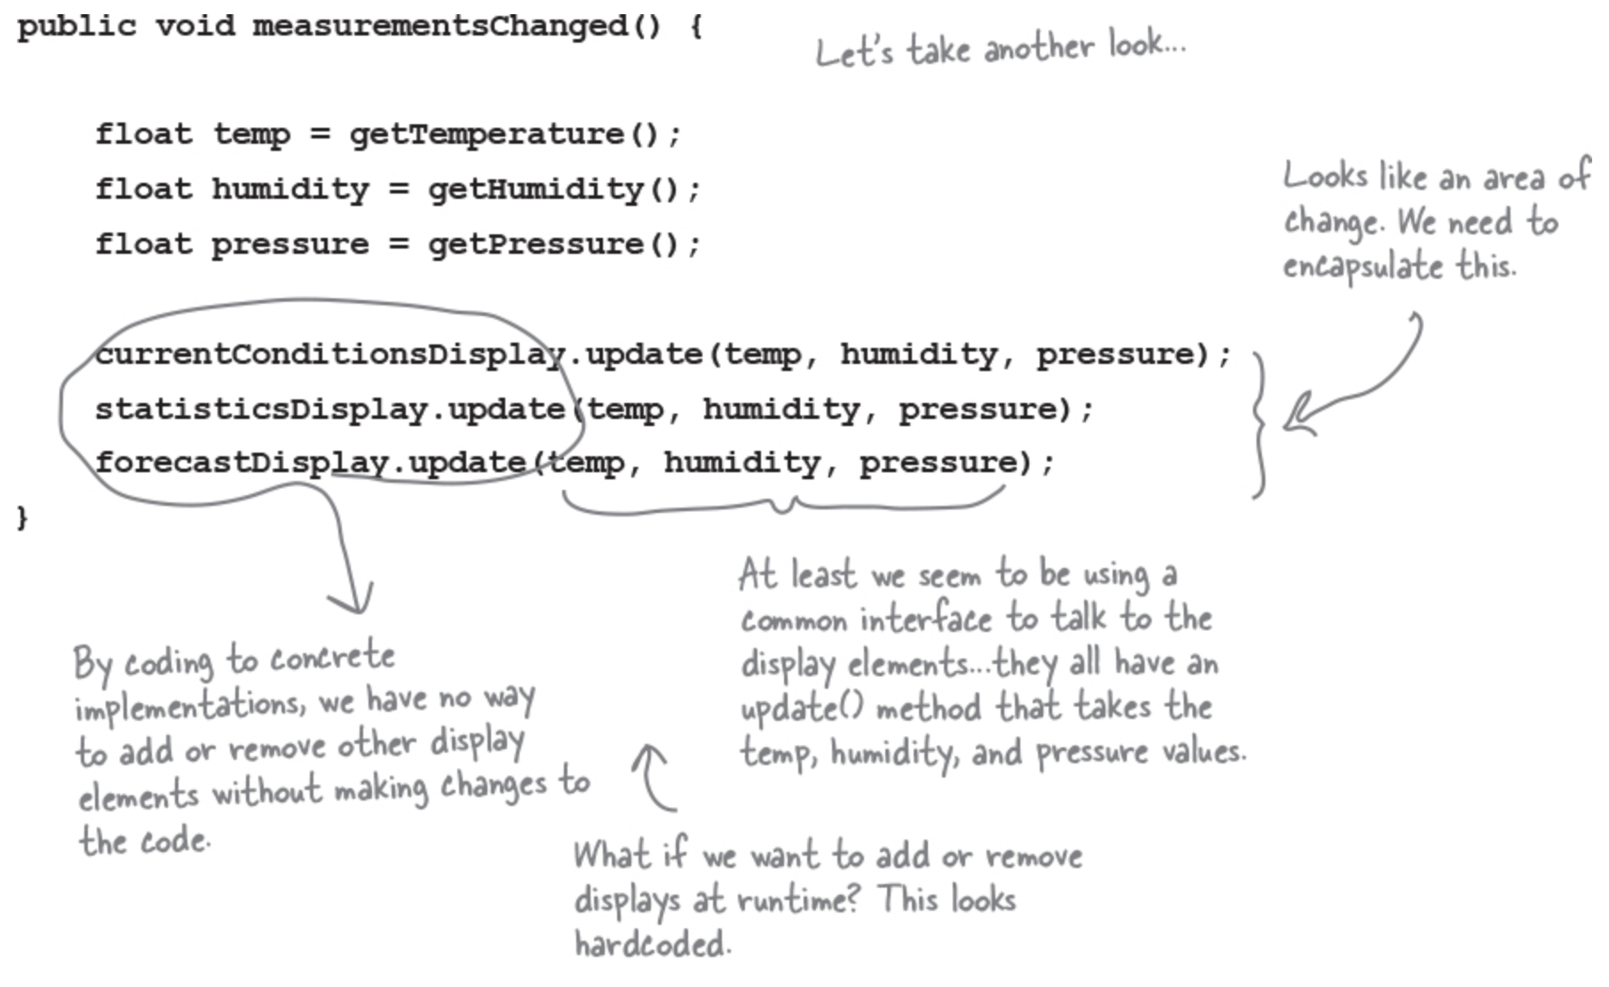
Big Data Analytics and Database Design
What’s wrong with our implementation anyway?
Think back to all those Chapter 1 concepts and principles—which are we violating, and which are we not?

Slide 12
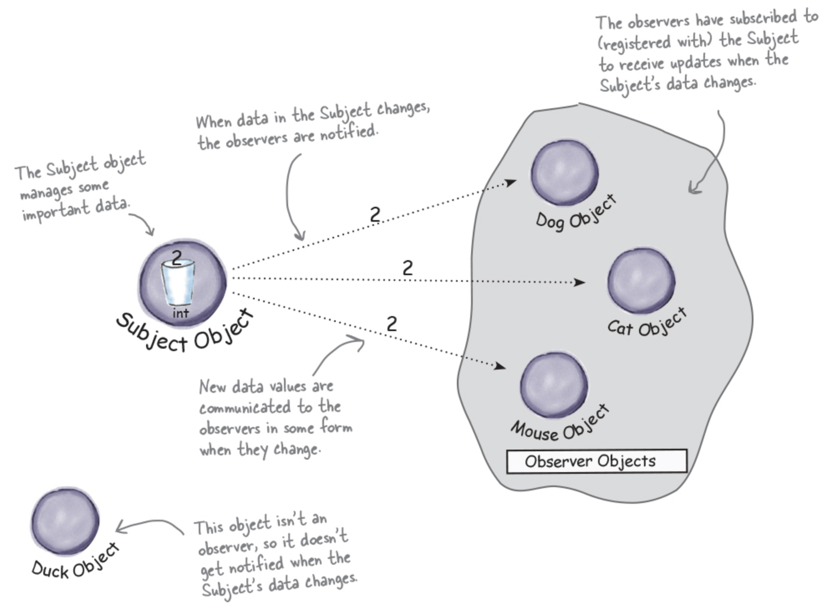
Big Data Analytics and Database Design
Subject + Observers = Observer Pattern

Slide 13
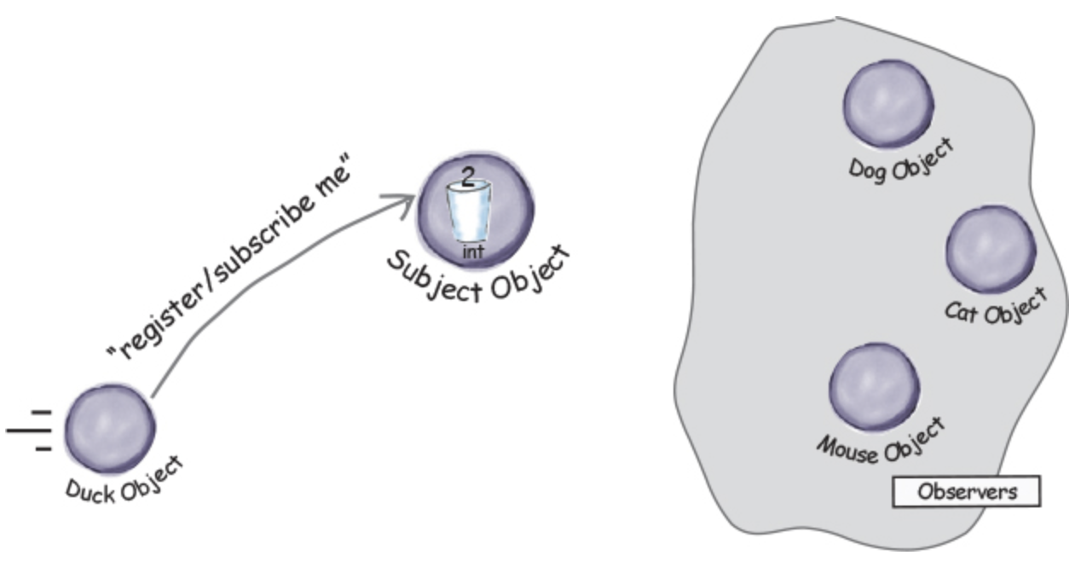
Big Data Analytics and Database Design
A day in the life of the Observer Pattern
A Duck object comes along and tells the Subject that he wants to become an observer.

Slide 14
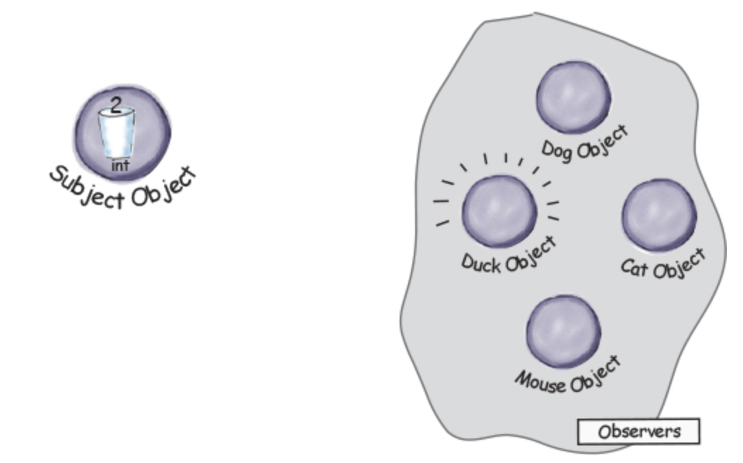
Big Data Analytics and Database Design
A day in the life of the Observer Pattern
The Duck object is now an official observer.

Slide 15
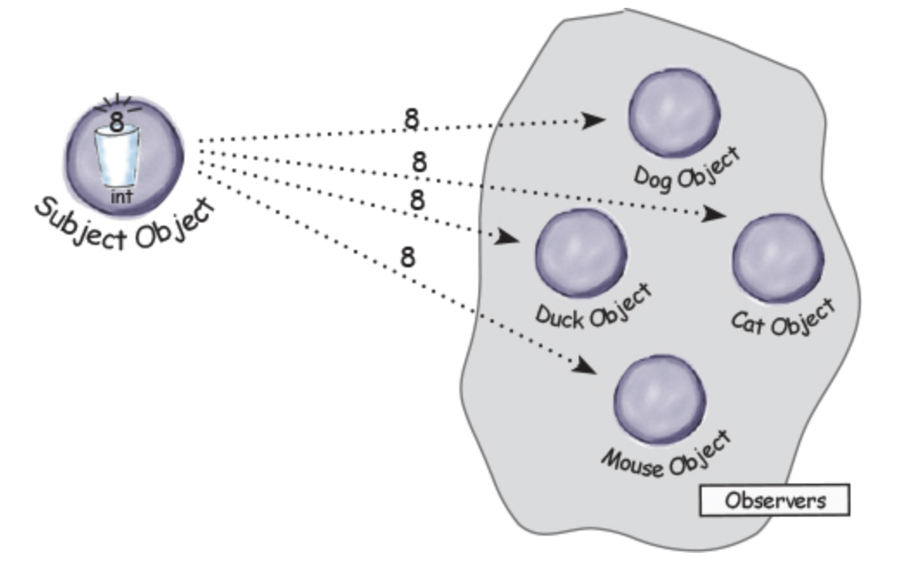
Big Data Analytics and Database Design
A day in the life of the Observer Pattern
The Subject gets a new data value!

Slide 16
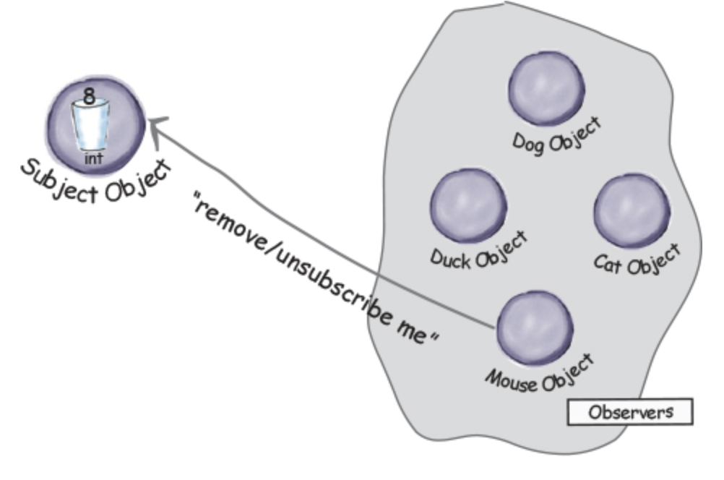
Big Data Analytics and Database Design
A day in the life of the Observer Pattern
The Mouse object asks to be removed as an observer.

Slide 17
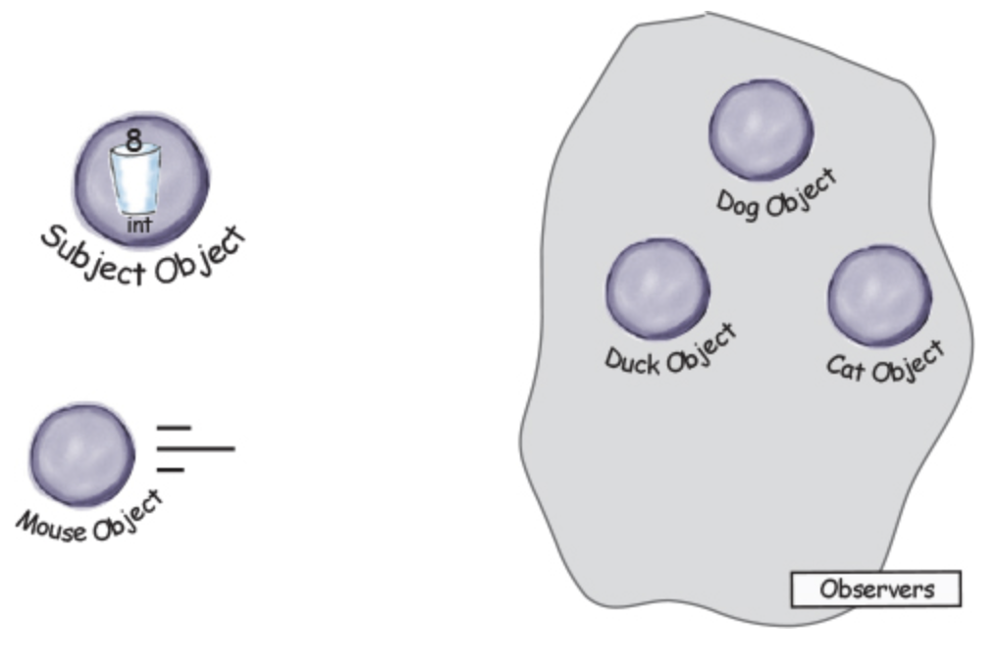
Big Data Analytics and Database Design
A day in the life of the Observer Pattern
Mouse is outta here!

Slide 18
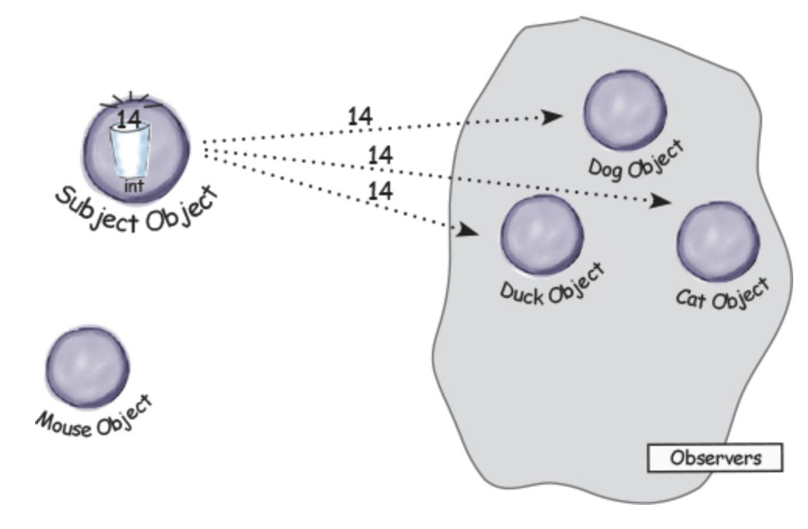
Big Data Analytics and Database Design
A day in the life of the Observer Pattern
The Subject has another new int.

Slide 19
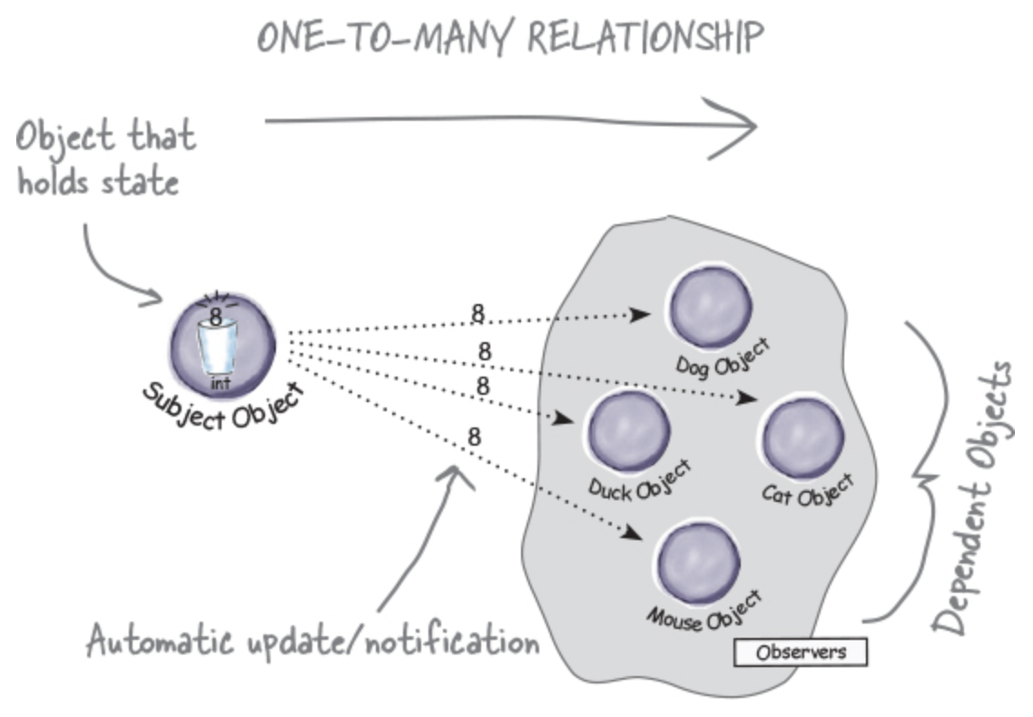
Big Data Analytics and Database Design
The Observer Pattern defined
The Observer Pattern defines a one-to-many dependency between objects so that when one object changes state, all of its dependents are notified and updated automatically.

Slide 20
Big Data Analytics and Database Design
The Observer Pattern defined
The Observer Pattern defines a one-to-many relationship between a set of objects.
When the state of one object changes, all of its dependents are notified.
The subject and observers define the one-to-many relationship. We have one subject, who notifies many observers when something in the subject changes. The observers are dependent on the subject—when the subject’s state changes, the observers are notified.

Slide 21
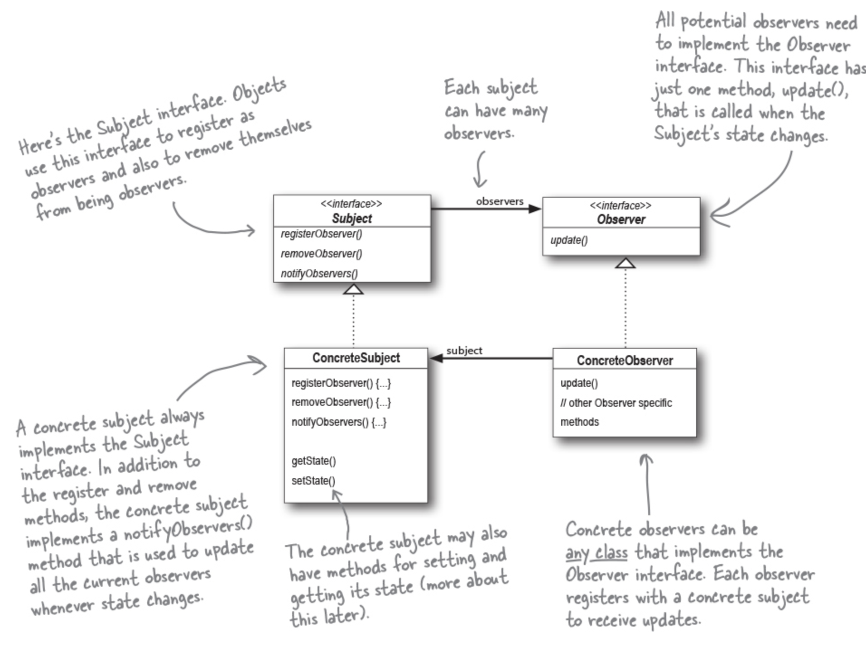
Big Data Analytics and Database Design
The Observer Pattern: the Class Diagram

Slide 22
Big Data Analytics and Database Design
The Power of Loose Coupling
When two objects are loosely coupled, they can interact, but they typically have very little knowledge of each other.
The Observer Pattern is a great example of loose coupling:
The only thing the subject knows about an observer is that it implements a certain interface (the Observer interface). It doesn’t need to know the concrete class of the observer, what it does, or anything else about it.
We can add new observers, remove or replace any observer at runtime with another observer.
We never need to modify the subject to add new types of observers.
We can reuse subjects or observers independently of each other.
Changes to either the subject or an observer will not affect the other.

Slide 23
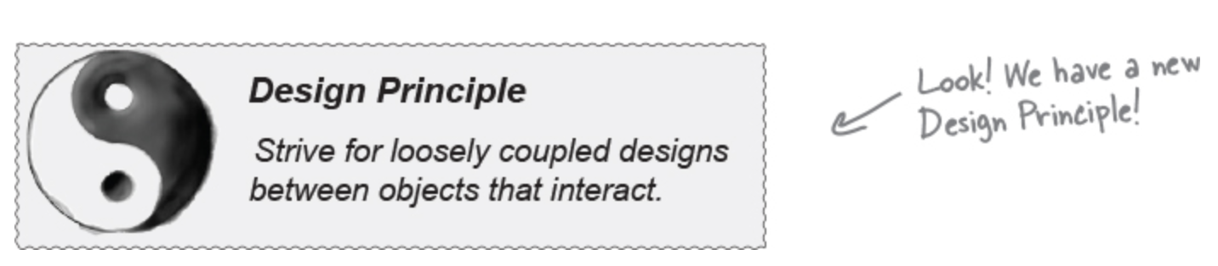
Big Data Analytics and Database Design
The Observer Pattern: the Class Diagram
Loosely coupled designs allow us to build flexible OO systems that can handle change because they minimize the interdependency between objects.

Slide 24
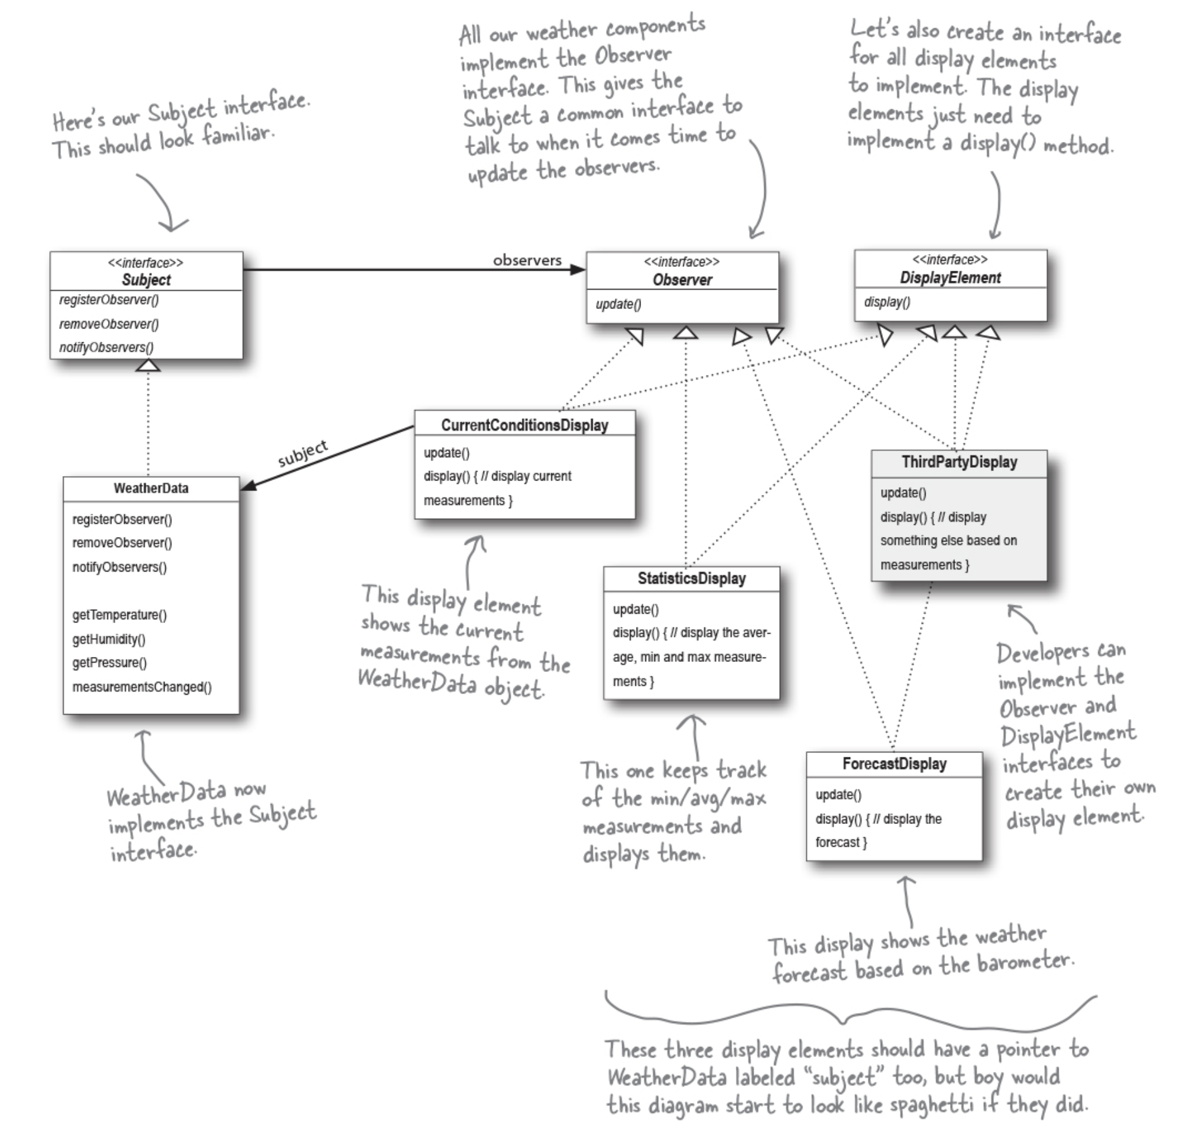
Big Data Analytics and Database Design
Designing the Weather Station

Slide 25
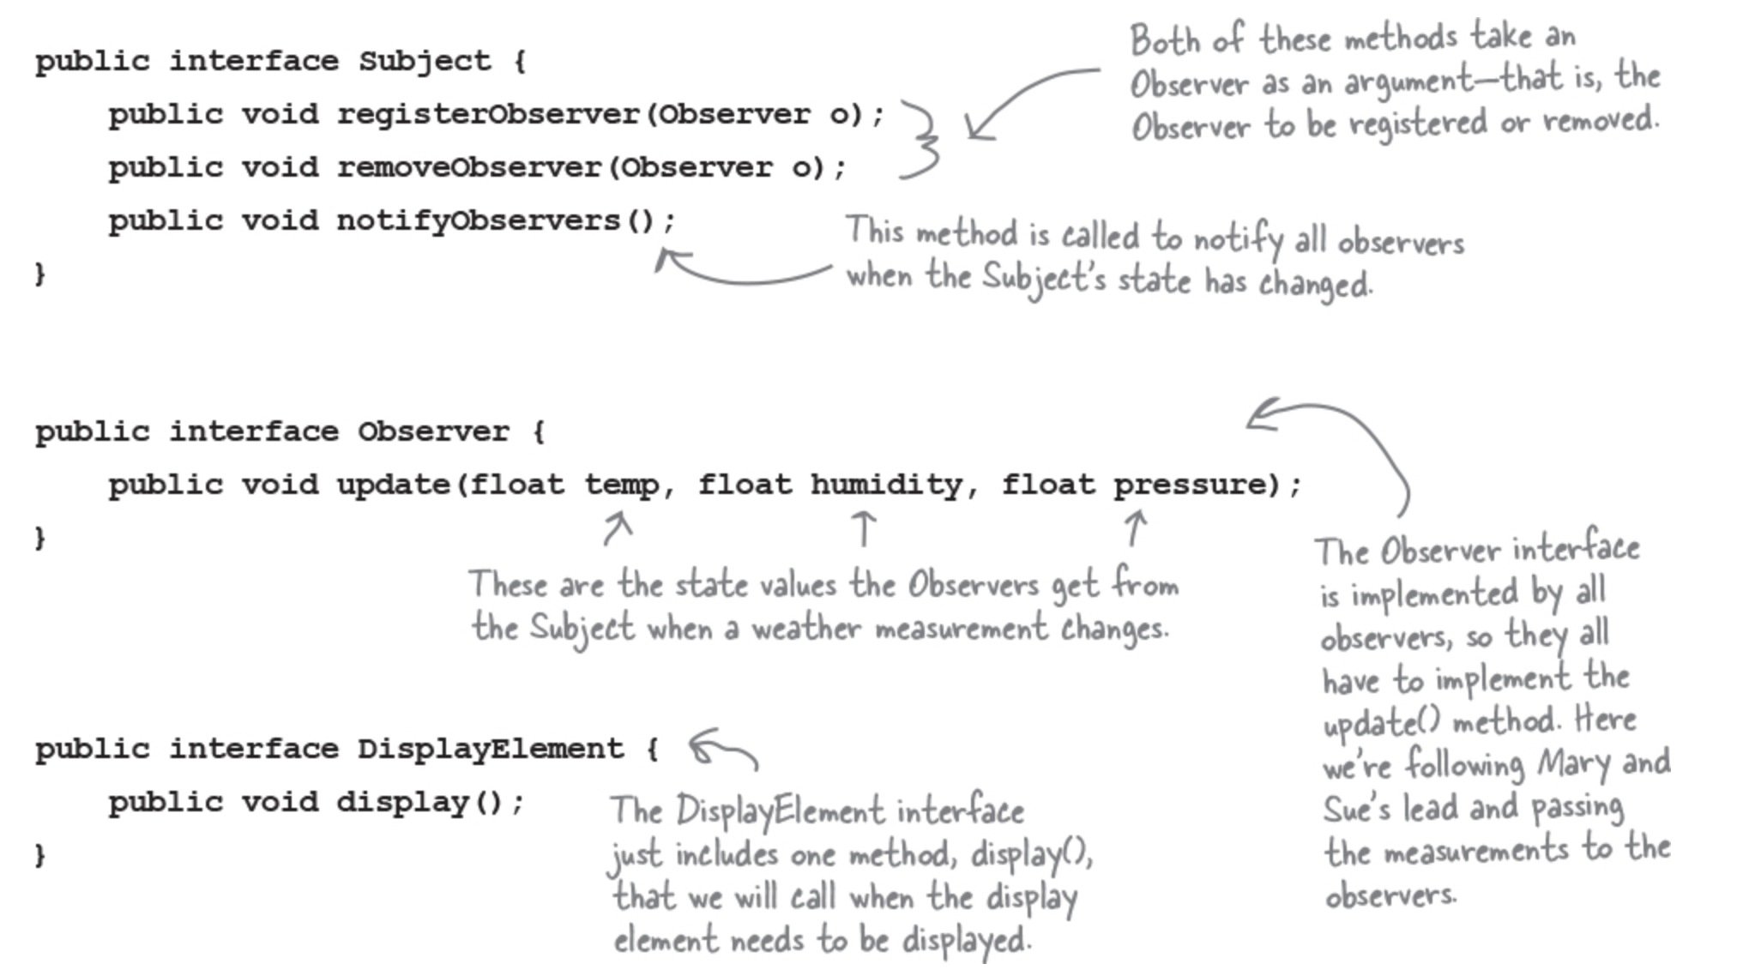
Big Data Analytics and Database Design
Implementing the Weather Station

Slide 26
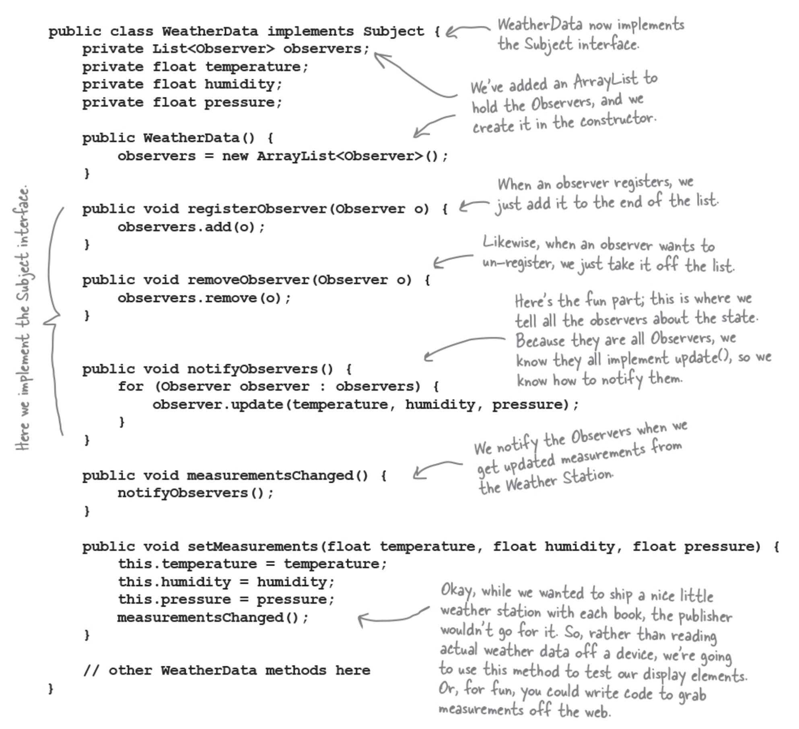
Big Data Analytics and Database Design
Implementing the Subject interface in WeatherData

Slide 27
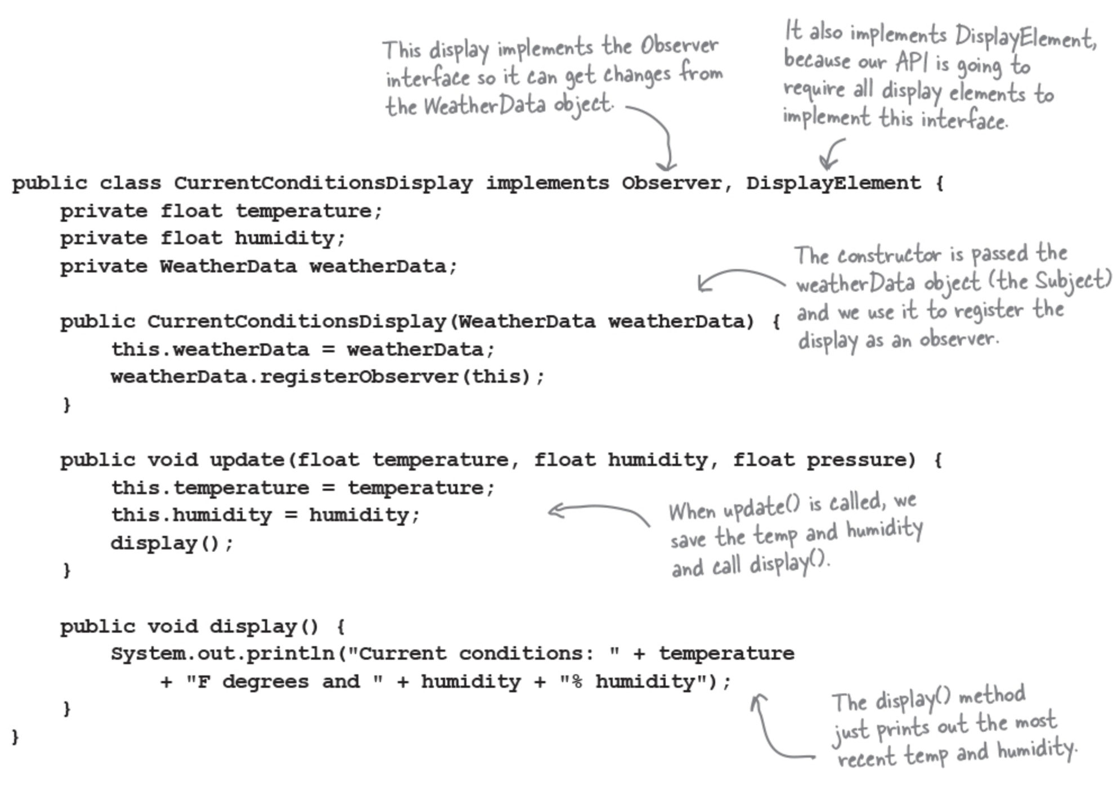
Big Data Analytics and Database Design
Now, let’s build those display elements

Slide 28
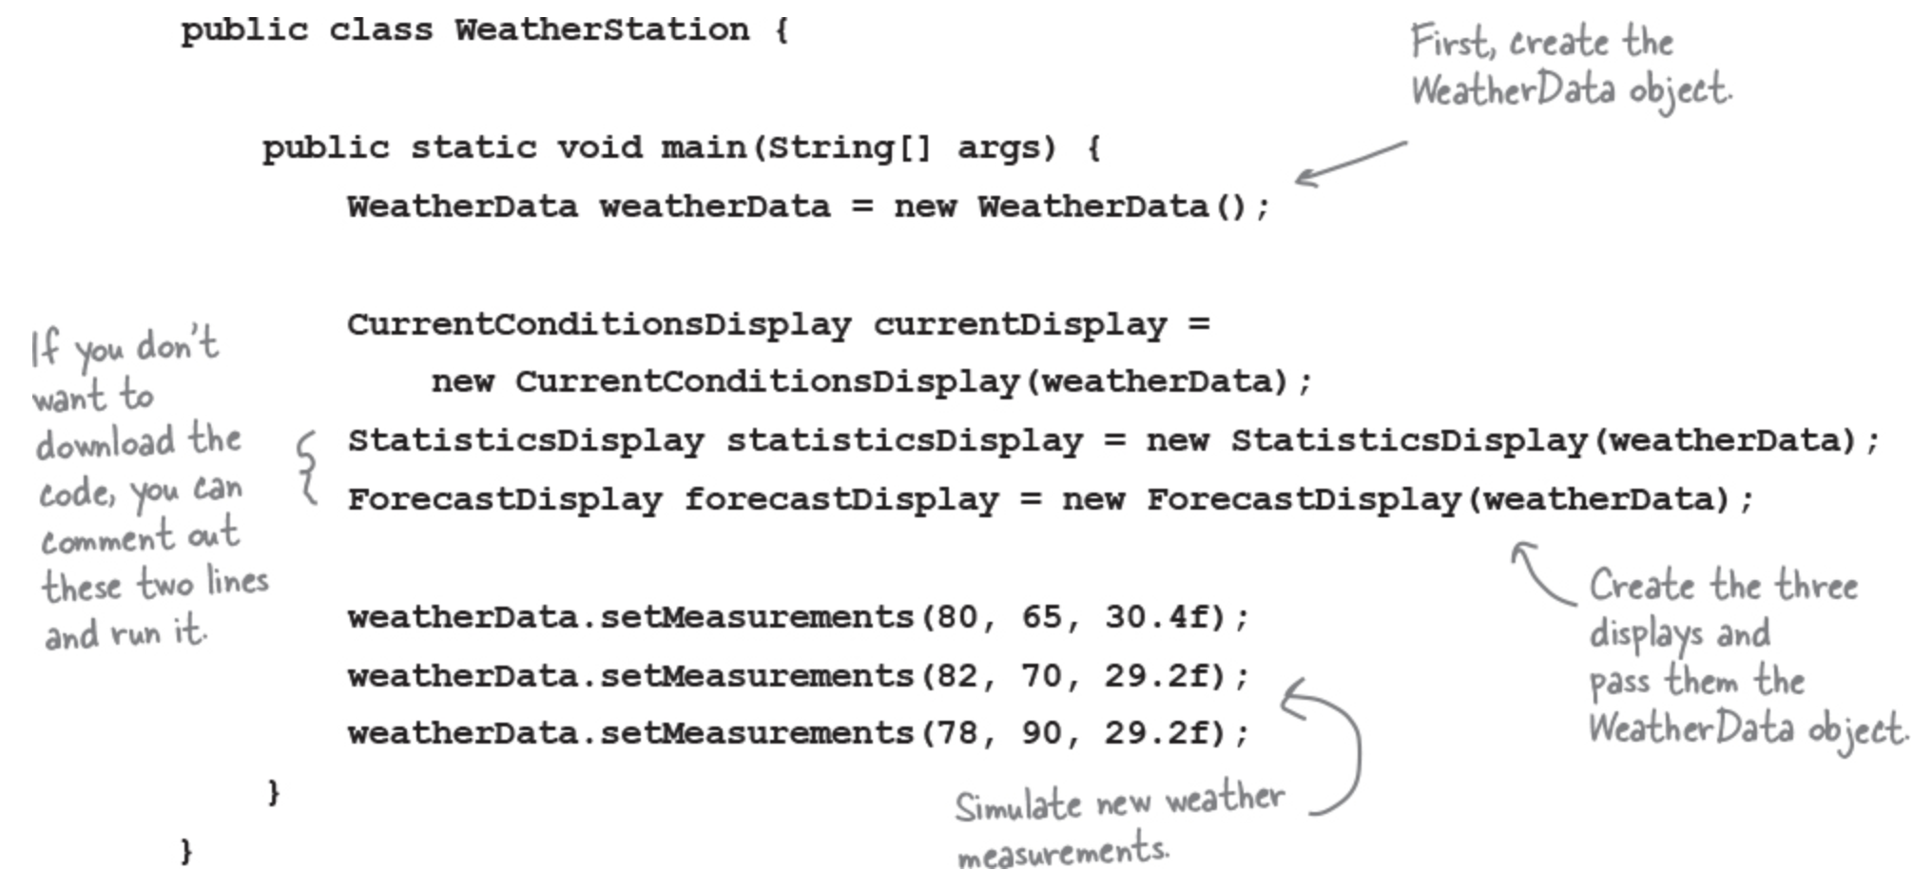
Big Data Analytics and Database Design
Test the Weather Station

Slide 29
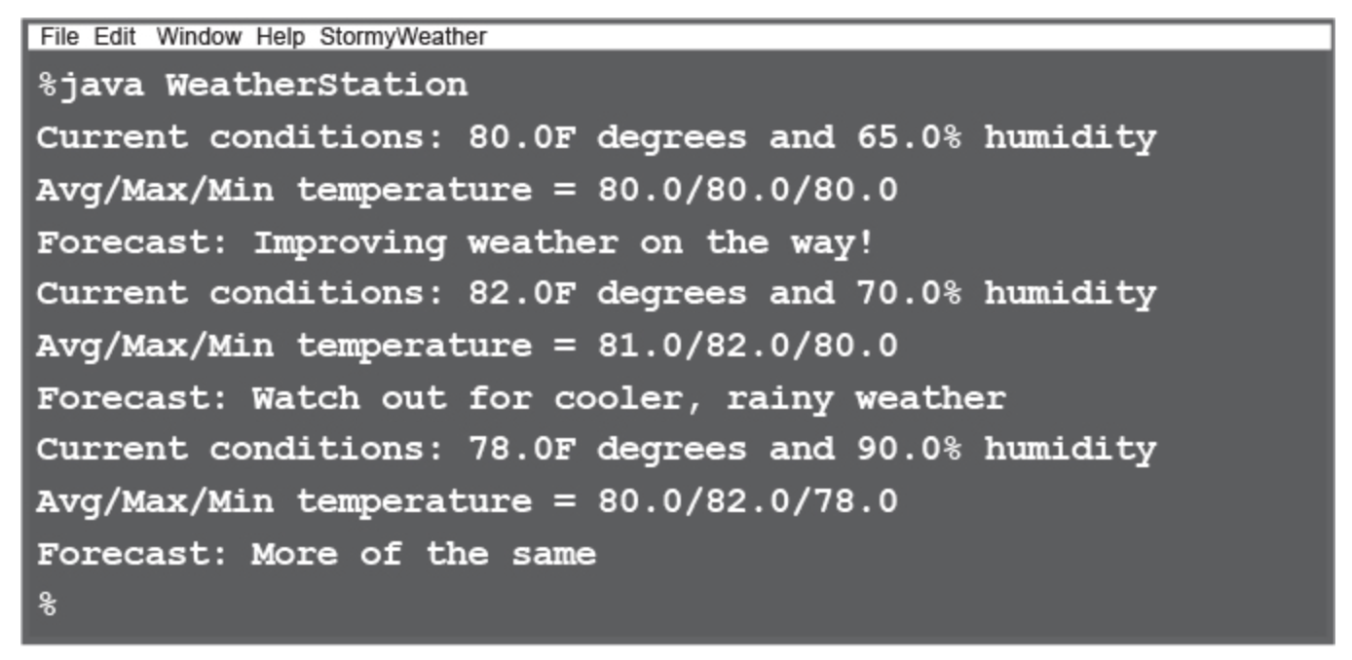
Big Data Analytics and Database Design
Run the code

Slide 30
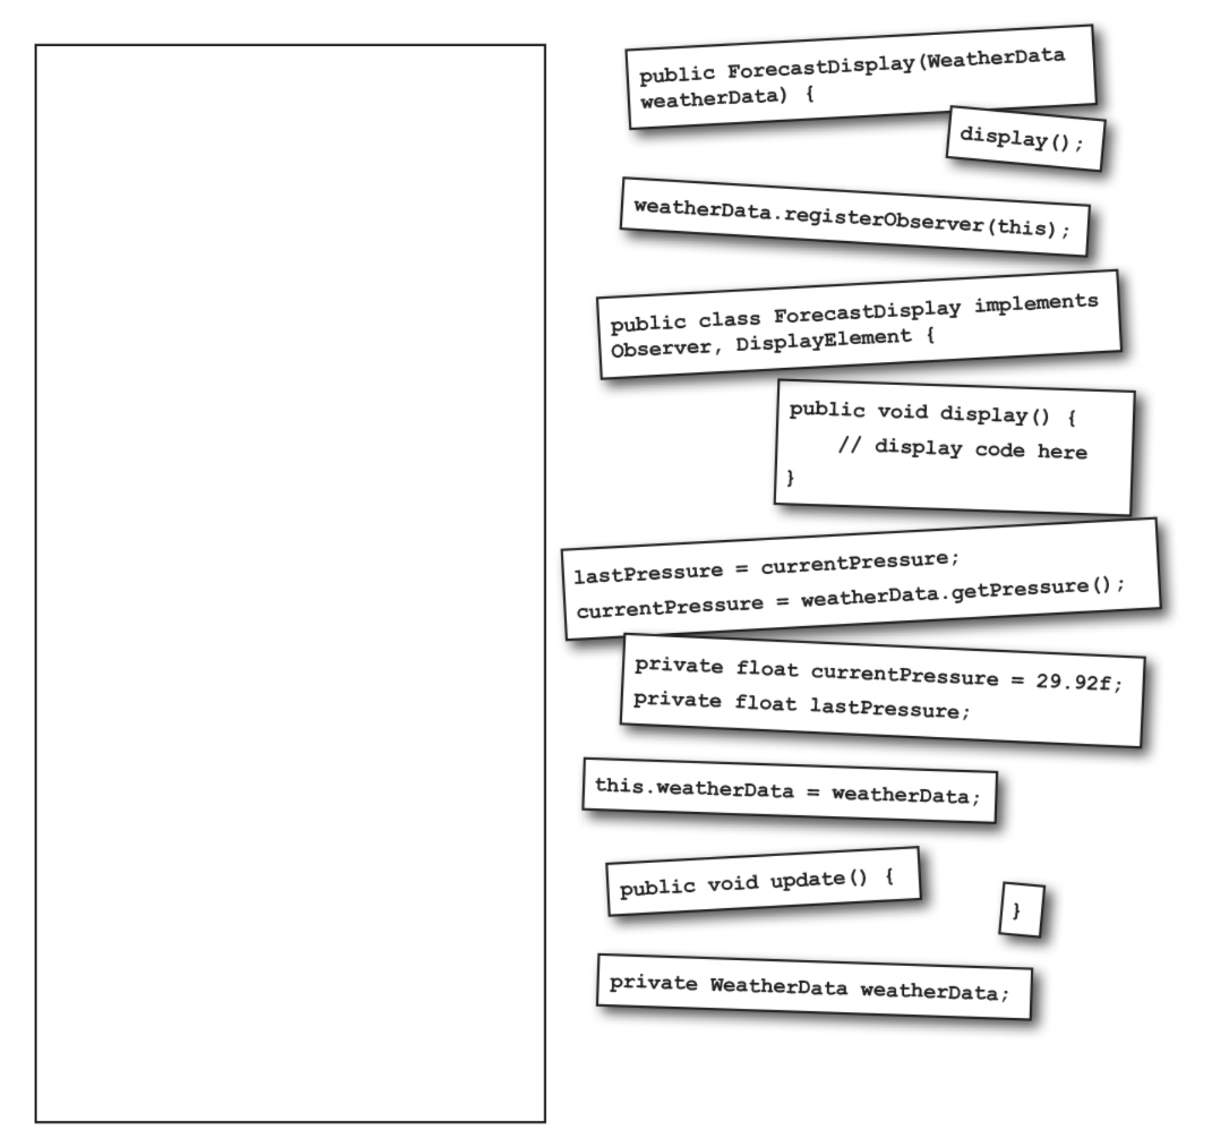
Big Data Analytics and Database Design
ForecastDisplay class

